Slide 1
Stochastic Flight Dynamics: A Monte Carlo Analysis of Rocket Trajectory Under Atmospheric Uncertainty
Quantifying the Impact Dispersion Zone and Mission Success Probability
Tolgahan Döner - 22290549
Ahmet Kerim Karık - 22290013

Slide 2


The Core Objective: Moving Beyond Deterministic Prediction
Standard deterministic models provide a single trajectory, failing to account for real-world environmental uncertainties like fluctuations in temperature and pressure.
This study's primary Objective is to conduct a high- fidelity flight simulation under stochastic atmospheric conditions to quantify the impact of this thermodynamic variability on operational performance.
By employing a Monte Carlo approach, we can move beyond a simple point estimate to:
Define a statistically robust ‘Impact Dispersion
Zone.’
Quantify the ‘Probability of Mission Success.’
Deterministic Prediction
Probabilistic Landscape

Slide 3

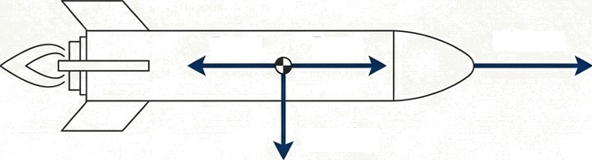
The Mathematical Framework: Point Mass Dynamics
The simulation is built upon the numerical integration of the equations of
motion in two dimensions.
The core model treats the rocket as a variable-mass system, accounting for
propellant consumption during the burn phase.
The rocket's motion is governed by Newton's Second Law (F=ma), where the net force is a vector sum of thrust, aerodynamic drag, and gravity.
All calculations are performed using a time-step integration method with a
granularity of dt = 0.01s to ensure high-fidelity results.
dt = 0.01s
Drag Move
Thrust
Gravity

Slide 4
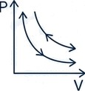



Governing Principles: The Laws of Physics in Code
The simulation integrates four fundamental physical principles to create a realistic flight
environment:
Newton's Second Law of
Motion
Forms the basis for calculating e acceleration from the net
forces acting on the rocket.
Thermodynamics of Ideal Gases
Used to accurately calculate air density (p = P / R-T) from pressure and temperature, which is critical for the drag calculation.
F=ma
Fluid Dynamics
Applied to model the aerodynamic drag force, which opposes the rocket's motion and is dependent on air density and velocity.
Newton's Law of Universal
Gravitation
Implemented to model the decrease in gravitational acceleration as the rocket's altitude increases.
G

Slide 5
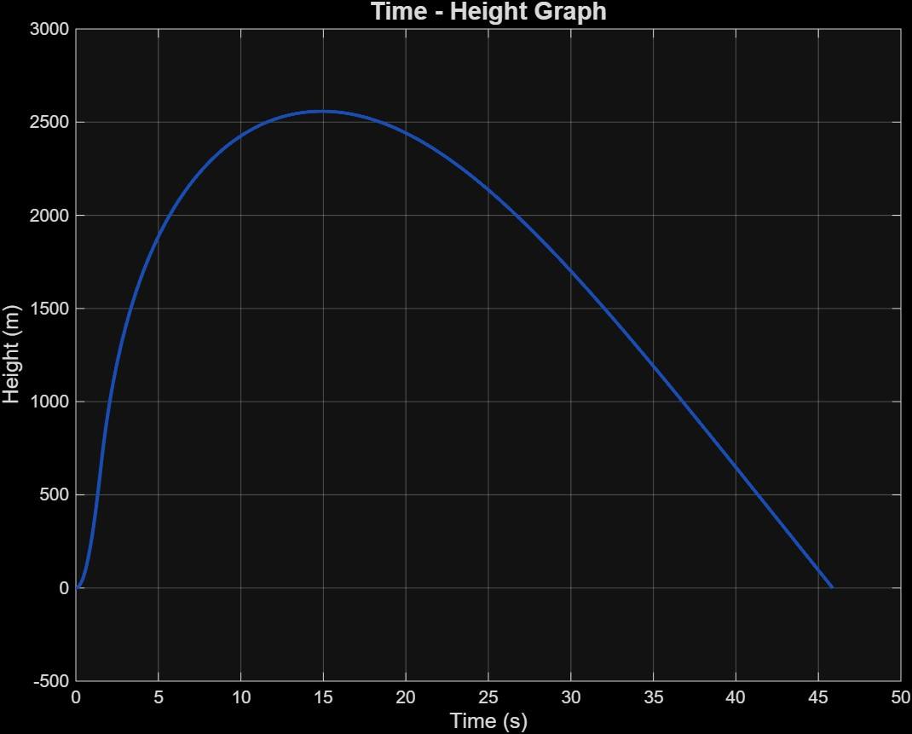
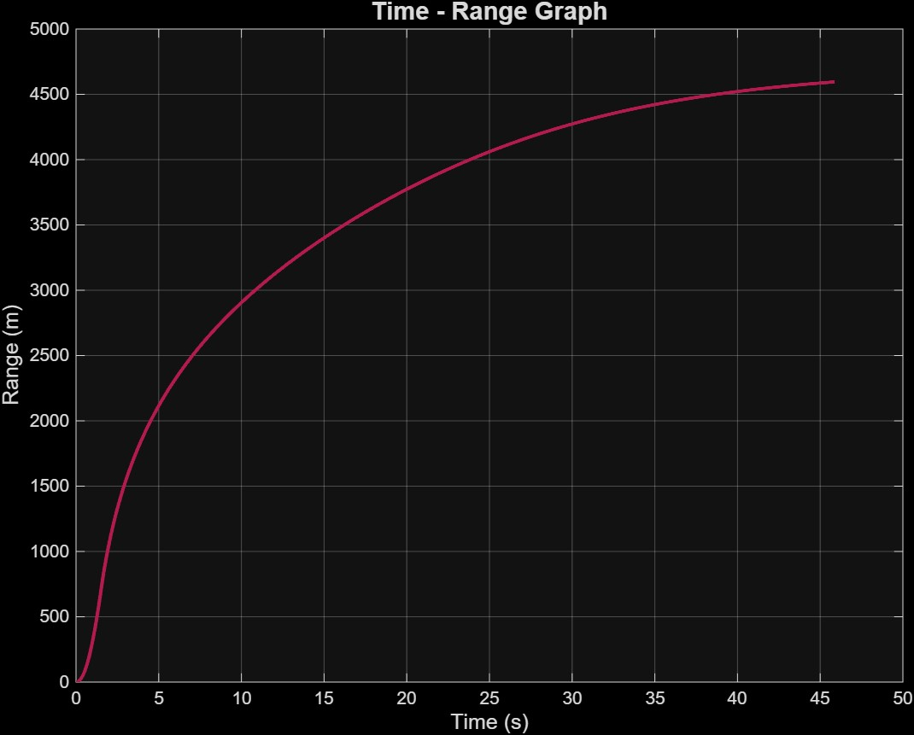
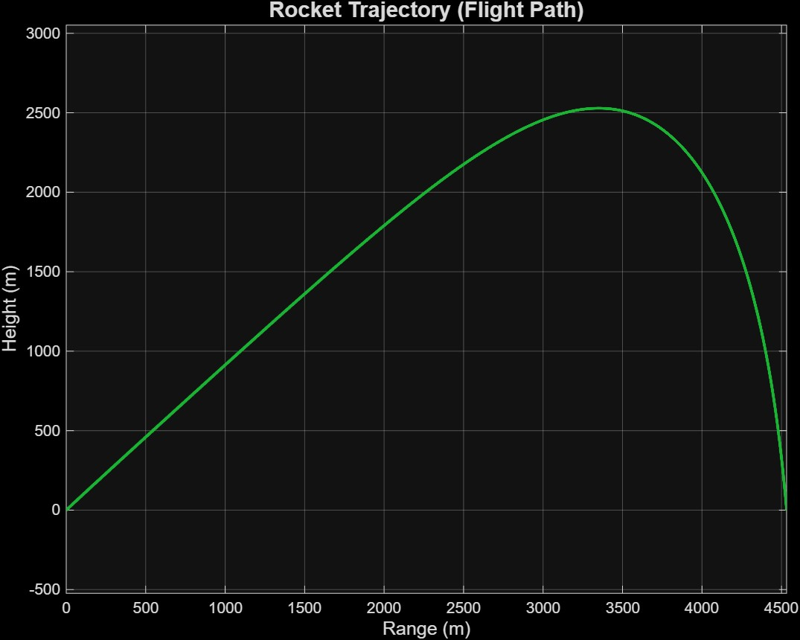
Height&Range Grapghics

Slide 6

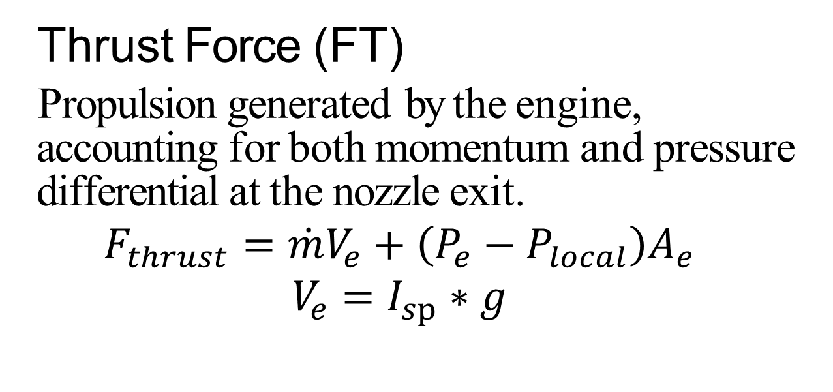
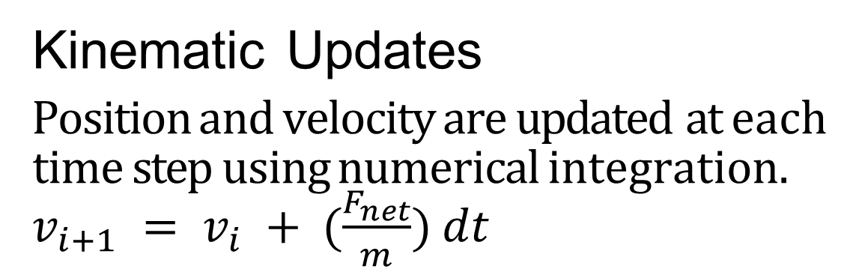
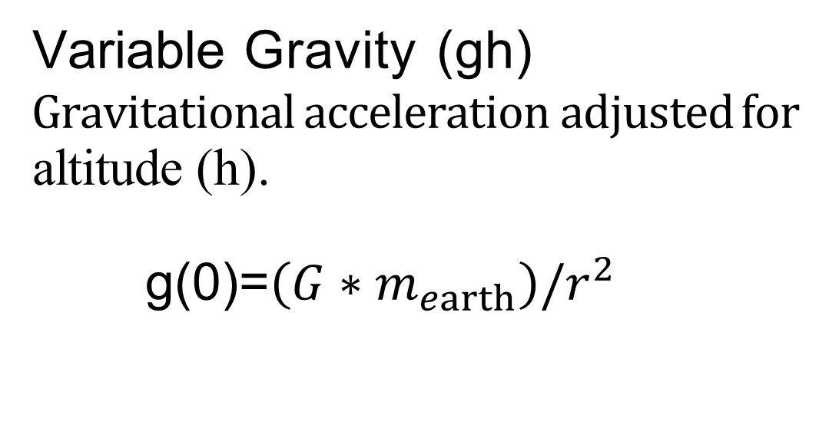
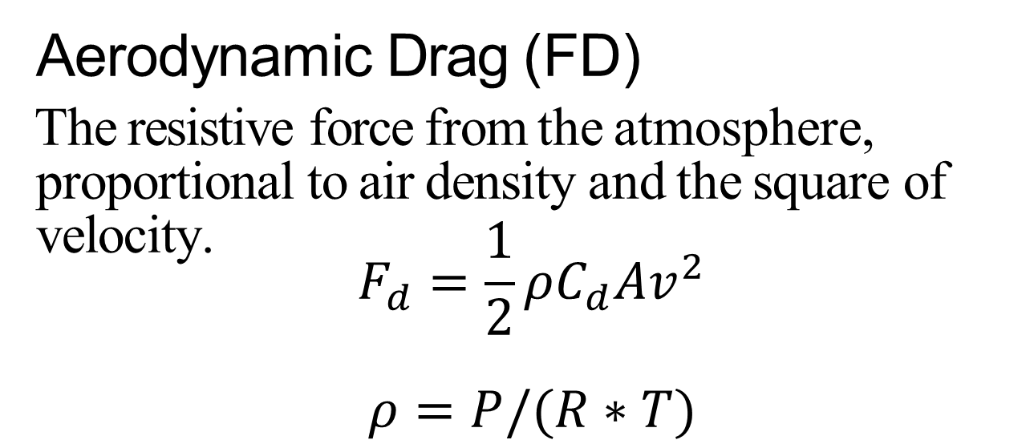
The Equations of Motion
Thrust Force (FT)
Propulsion generated by the engine, accounting for both momentum and pressure differential at the nozzle exit.
$$F_{thrust}=\dot{m}V_{e}+\left(P_{e}−P_{local}\right)A_{e}$$
$$V_{e}=I_{sp}∗g$$
Aerodynamic Drag (FD)
The resistive force from the atmosphere, proportional to air density and the square of velocity.
$$F_{d}=\frac{1}{2}ρC_{d}Av^{2}$$
$$ρ=P/(R∗T)$$
Variable Gravity (gh)
Gravitational acceleration adjusted for
altitude (h).
g(0)=$\left(G∗m_{earth}\right)/r^{2}$
Kinematic Updates
Position and velocity are updated at each time step using numerical integration.
$v_{i+1} = v_{i} + (\frac{F_{net}}{m}) dt$
G

Slide 7
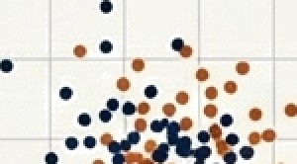
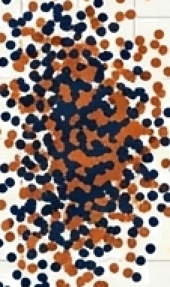

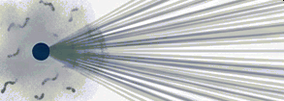
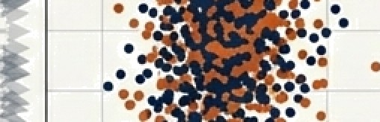

The Method: Introducing Uncertainty via Monte Carlo Simulation
A Monte Carlo Simulation is a computational algorithm that relies on repeated random sampling to obtain numerical results and understand the impact of uncertainty.
Instead of a single run with average conditions, we perform 2,000 independent flight iterations.
Each iteration uses a slightly different, randomly generated set of initial atmospheric conditions.
This process allows us to build a statistical distribution of all possible outcomes, transforming a single point prediction into a probabilistic landscape.
Initial
Conditions
Deterministic Run
Monte Carlo
Runs
Probabilistic Outcomes
G

Slide 8
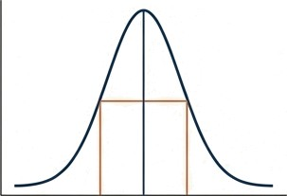

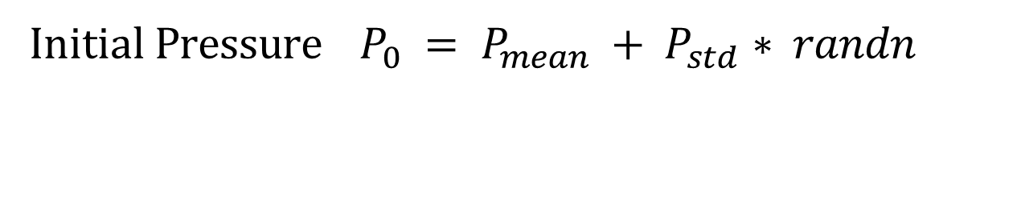
Implementing Randomness: Stochastic & Dynamic Variables
Random Variable Assignment
To simulate real-world atmospheric variability, initial conditions are assigned from a Normal (Gaussian) Distribution:
Initial Temperature $T_{0} = T_{mean} + T_{std} ∗ randn$
Initial Pressure $P_{0} = P_{mean} + P_{std}∗ randn$
Key Dynamic Variables
The following parameters change within each of the 2,000 simulation runs:
Initial Air Density: Varies at the start of each run due to randomized T_{O} rind P₀.
Instantaneous Mass: Decreases linearly as propellant is consumed during the 1.5s engine burn.
Local Gravity: Decreases as the rocket gains altitude.
Drag Force: Changes continuously as the rocket's velocity and the local air density change.

Slide 9
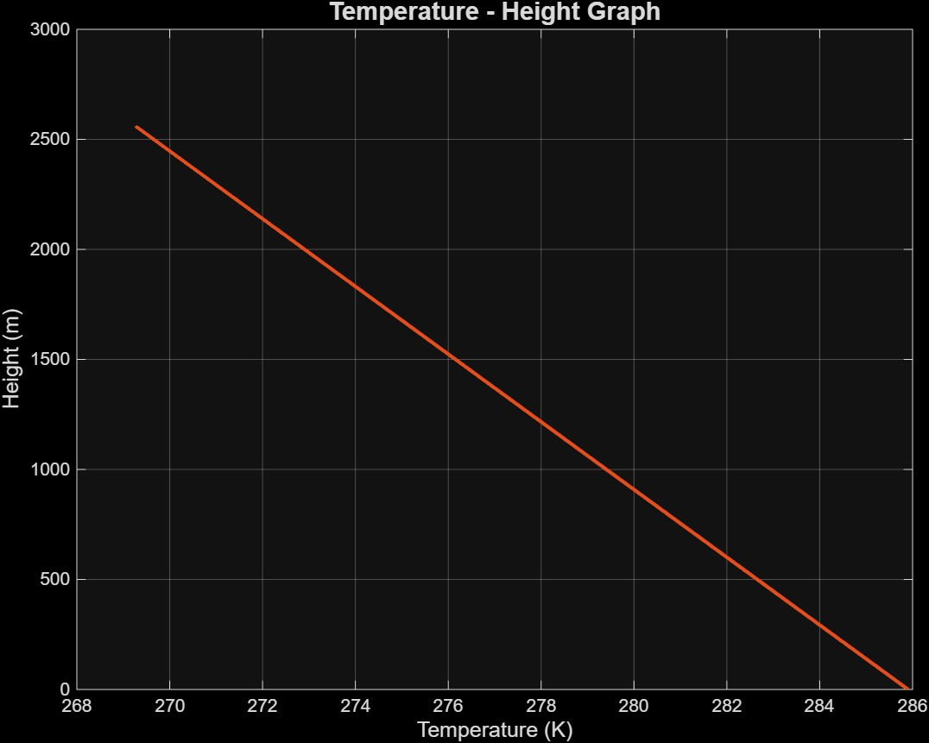
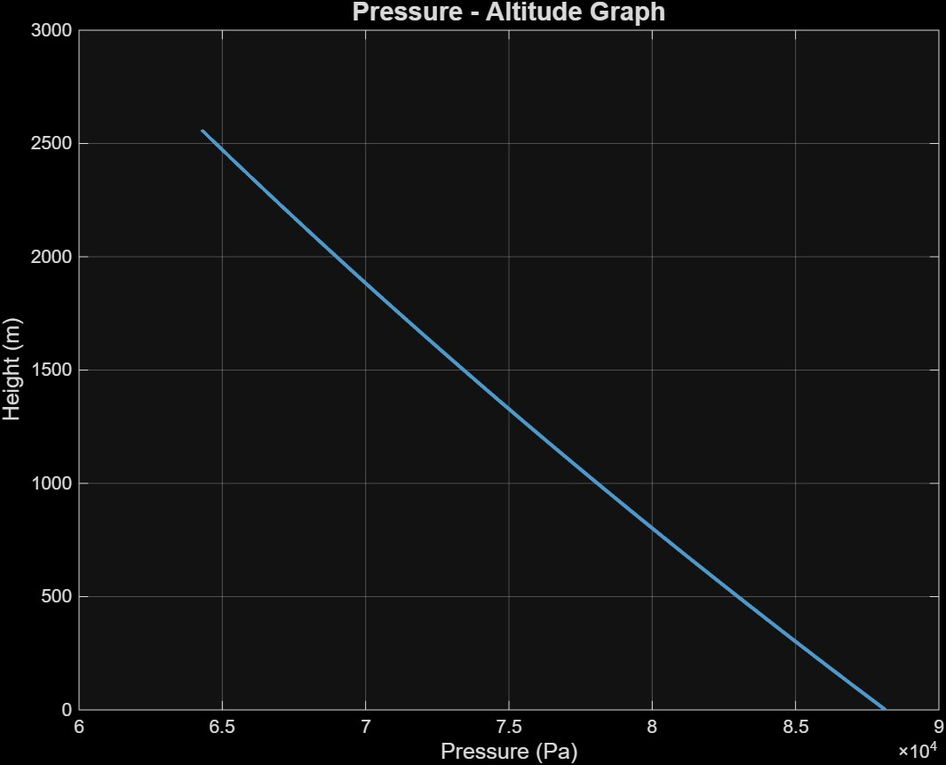
Atmospheric Model Part 1: Vertical Temperature & Pressure Profiles
The simulation implements a physically accurate vertical profile of the troposphere based on the International Standard Atmosphere (ISA) model.
Altitude vs. Temperature: Temperature decreases linearly with altitude according to a standard lapse rate (L = 0.0065 K/m)
Altitude vs. Pressure: Atmospheric pressure decreases exponentially with altitude. This is critical for calculating both air density and the pressure thrust component of the engine.

Slide 10
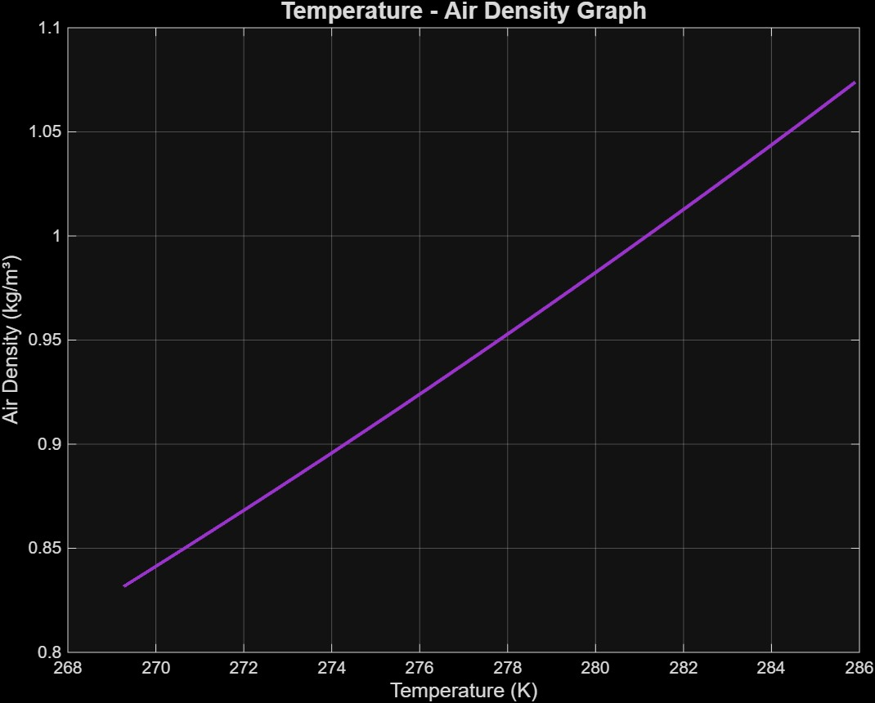
Temperature - Air Density Graph
Atmospheric Model Part 2: Thermodynamic Coupling
The atmospheric variables are not independent. They are coupled through the Ideal Gas Law, ensuring the model maintains hydrostatic equilibrium. Air density is directly calculated from the local pressure and temperature at each altitude step. This relationship is fundamental to the simulation's accuracy, as the constantly changing air density directly impacts the magnitude of the aerodynamic drag force, a primary factor in the rocket's trajectory.
G

Slide 11
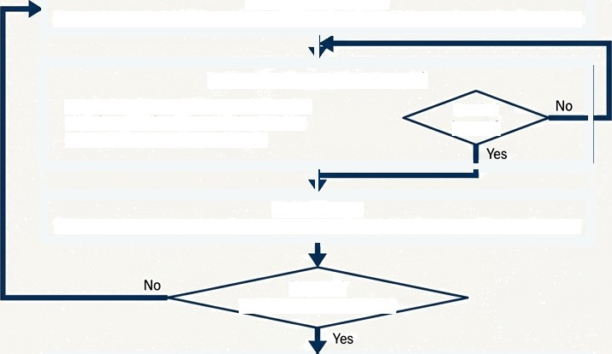
Simulation Logic Flow
The code executes a structured loop for each of the 2,000 iterations to generate the final dataset. This diagram illustrates the high-level process flow.
Initialization Set fixed rocket parameters (Cd, A, mfuel, etc.)
Stochastic Sampling Randomly sample initial Temperature (T) and Pressure (P) from a Gaussian distribution.
Integration Loop (Time Step dt) Calculate Forces (Thrust, Drag, Gravity) _{Ground} Update Acceleration, Velocity, Position _{!mpact?} Check far ground impact (y < 0)
Data Storage If loop terminates, record the final range and maximum altitude achieved for the iteration.
Repeat?
00 iterations completed
Post-Processing
Analyze the stored data to generate statistical plots (PDF, CDF, 2D Maps).

Slide 12
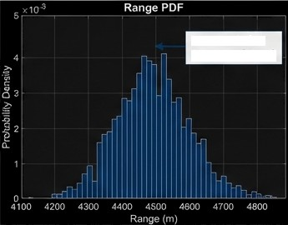
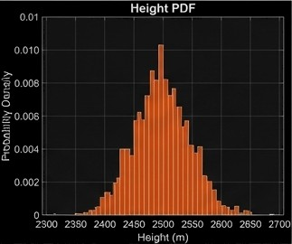
Interpreting Outcomes: Probability Density Function
Must Probable Outcome
The Probability Density Function (PDF) displays the frequency of specific outcomes across all 2,000 simulated flights. It shows us where the results are most likely to fall.
The distinct 'bell curve' (Gaussian-like) shape observed in both range and height distributions confirms that the rocket's performance is stable and predictable.
The peak of the curve represents the most probable outcome (the mean), with outcomes becoming progressively less likely as they move away from the center.

Slide 13
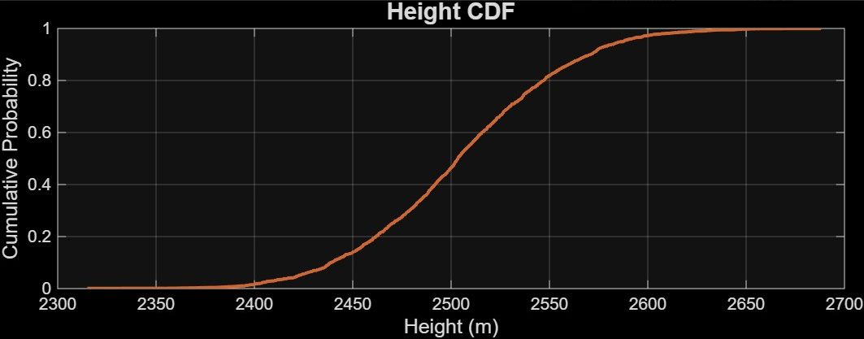
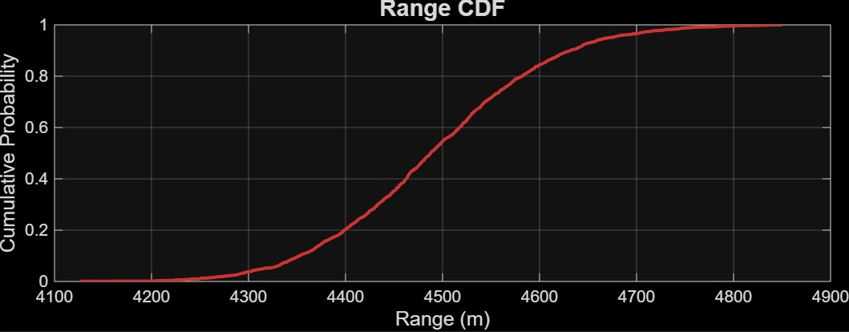
Quantifying Risk: Cumulative Distribution Function (CDF)
The Cumulative Distribution Function (CDF) shows the probability that an outcome will be less than or equal to a certain value. It is a powerful tool for risk assessment.
For example, by finding the 0.95 (95%) point on the Y-axis and reading the corresponding X-axis value, we can determine the performance threshold below which 95% of all flight outcomes are expected to fall.
This allows us to establish a scientifically grounded confidence interval for mission planning and safety assurance.

Slide 14
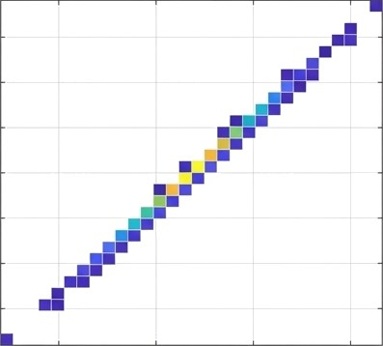

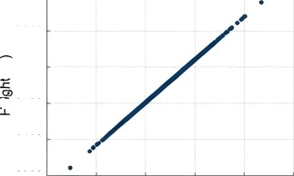
Visualizing the Impact Zone: The 2D Performance Model
2D Density Map
8y plotting peak altitude versus final range for all 2,000 iterations, we can visualize the system's combined performance envelope.
200
2650
2600
150
2550
2500
100
The 2D Density Map visualizes the 'Impact Dispersion.' The color intensity represents the concentration of outcomes, with 'hotspots' indicating the highest probability performance zones.
2450
2400
50
2350
yyy Range vs. Altitude Relationship
2
4200 4400 4600 4800
Range (m)
The strong positive linear correlation seen in the scatter plot confirms that flights achieving higher altitudes consistently travel a greater range, as they spend more time in thinner upper-atmospheric layers with reduced drag.
2600
E 2500
% 2400
2400
2300
4000 4200 4400 4600 4800 5000
Range (m)

Slide 15




Key Results & Professional Insights
The statistical analysis of 2,000 flight iterations yields several critical insights into the system's performance and robustness:
High Dispersion Stability: The low standard deviation observed in the results
indicates that the rocket design is highly resilient to atmospheric noise and variations.
Thermodynamic Model Validation: The simulated atmospheric profiles for temperature, pressure, and density align perfectly with the International Standard Atmosphere (ISA) model, validating the core ’physics engine' of the simulation.
Strong Performance Correlation: A clear and strong positive correlation exists
between the peak altitude achieved and the final range of the vehicle.
System Reliability: The tight clustering of outcomes in the 2D impact model suggests a highly reliable and predictable vehicle design under varying thermodynamic stresses.
G

Slide 16
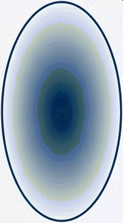
Conclusion: From Uncertainty to Engineering Confidence
This study successfully demonstrates the power of Monte Carlo analysis in moving beyond a single deterministic prediction to create a robust statistical model of flight performance.
The analysis validates the rocket design as aerodynamically sound and statistically predictable.
The key contribution is the quantification of a confidence interval, or safety buffer, which is an essential tool for real-world mission planning, risk assessment, and operational safety assurance.
Ultimately, this approach transforms atmospheric uncertainty from an unknown risk into a manageable, well-defined performance parameter.
Monte Carlo
Analysis
Unknown Risk
Defined Performance Parameter

